Slide 1
Book recommendation system
Varsha R. Chintamani
F Mohammed Hamdhan
Himangi
S Sharmili
Kajal Kumari
Mupparam Srividya

Slide 2

Summary:
OBJECTIVE:
The aim of this project is to build a recommendation engine using the Book-Crossing dataset, which includes user ratings.
Performing EDA on individual datasets
Merging of dataset
Model Building
Model Evaluation
Model Deployment

Slide 3
Dataset details
The dataset is comprised of three csv files:: User, Books, Ratings
1.Users_dataset.
User-ID (unique for each user)
Location (contains city, state and country separated by commas)
Age Shape of Dataset - (278858, 3)
2. Books_dataset.
ISBN (unique for each book)
Book-Title
Book-Author
Year-Of-Publication
Publisher Shape of Dataset - (271360, 8)
3.Ratings_dataset.
User-ID
ISBN
Image-URL-S
Image-URL-M
Image-URL-L Shape of Dataset - (1149780, 3)

Slide 4
1: perform exploratory data analysis on individual datasets

Slide 5
INVESTIGATING USERS Dataset
index | user_id | location | age
0 | 1 | nyc, new york, usa | NaN
1 | 2 | stockton, california, usa | 18.0
2 | 3 | moscow, yukon territory, russia | NaN
3 | 4 | porto, v.n.gaia, portugal | 17.0
4 | 5 | farnborough, hants, united kingdom | NaN
Tidied the column names
Found that all user ID’s are unique
Found the data types of respective columns and changed the age data type from float to int
The age range goes from 0 to 244 years old! Obviously this cannot be correct; I'll set all ages less than 5 and older than 100 to NaN to try keep them realistic.
Now the ages go from 5 to 100, with missing values entered as NaN. Let's plot this to see how they are distributed. There are 112010 empty age values in our set of 278858 users (or 40.17%).
It seems that most of our reviewers are in their late 20s to early 30s. (Next slide)

Slide 6
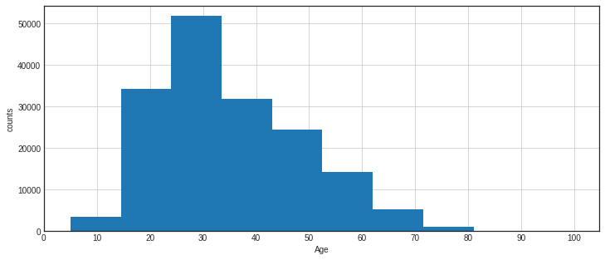
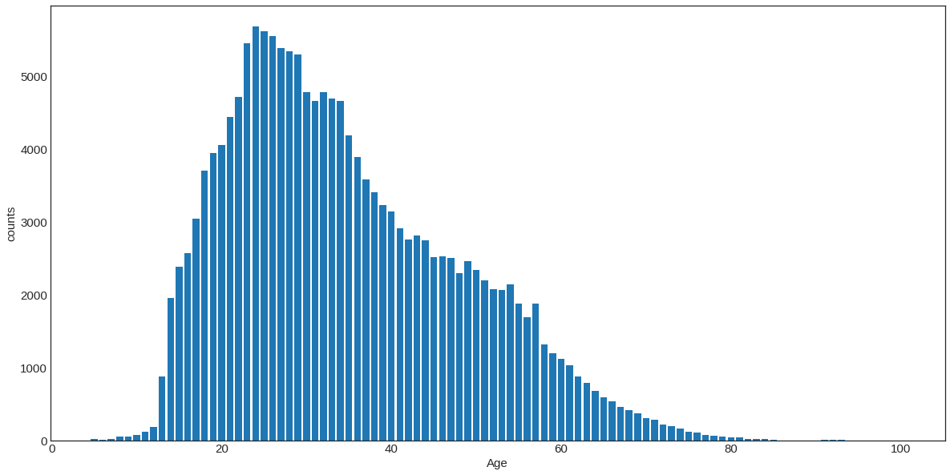
AGE COUNT-PLOT
AGE PLOT WITH 10 BINS
SAME PLOT WITHOUT BINNING

Slide 7
We expand the locations field
 | User_id | age | city | state | Country
0 | 1 | NaN | nyc | new york | usa
1 | 2 | 18.0 | stockton | california | usa
2 | 3 | NaN | moscow | yukon territory | russia
3 | 4 | 17.0 | porto | v.n.gaia | portugal
4 | 5 | NaN | farnborough | hants | united kingdom

Slide 8
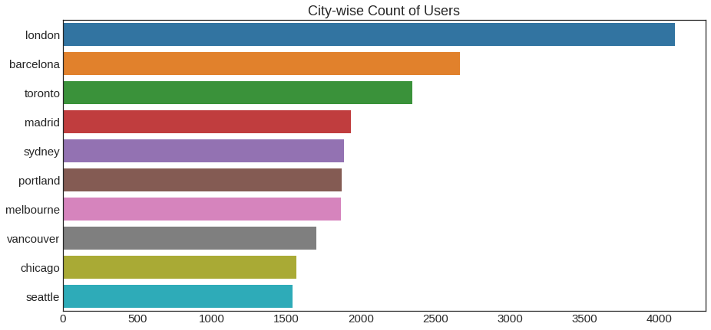
TOP 10 CITIES in the dataset
LONDON | 4105
BARCELONA | 2664
TORONTO | 2342
MADRID | 1933
SYDNEY | 1884
PORTLAND | 1869
MELBOURNE | 1863
VANCOUVER | 1699
CHICAGO | 1566
SEATTLE | 1541

Slide 9
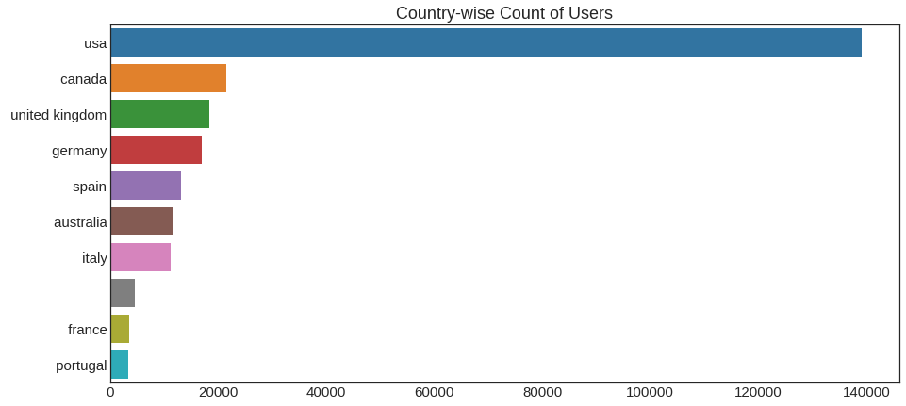
Top 10 countries in the dataset
USA | 139183
CANADA | 21556
UNITED KINGDOM | 18286
GERMANY | 17021
SPAIN | 13088
AUSTRALIA | 11719
ITALY | 11238
 | 4561
FRANCE | 3440
PORTUGAL | 3305

Slide 10
It looks like an empty ‘Country’ field is in the top 10 most common entries
We change these empty strings to NAN
There are 4561 entries with empty strings, and 2 NaN entries in the Country field
User_id | 0
Age | 0
City | 0
State | 1
Country | 4563

Slide 11
INVESTIGATING BOOKS DATASET
 | isbn | book_title | book_author | year_of_publication | publisher
0 | 0195153448 | Classical Mythology | Mark P. O. Morford | 2002.0 | Oxford University Press
1 | 0002005018 | Clara Callan | Richard Bruce Wright | 2001.0 | HarperFlamingo Canada
2 | 0060973129 | Decision in Normandy | Carlo D'Este | 1991.0 | HarperPerennial
3 | 0374157065 | Flu: The Story of the Great Influenza Pandemic... | Gina Bari Kolata | 1999.0 | Farrar Straus Giroux
4 | 0393045218 | The Mummies of Urumchi | E. J. W. Barber | 1999.0 | W. W. Norton &amp; Company

Slide 12
Tidied the column names
Removed image urls from the dataset
Changed the year_of_publication data type from object to float
Checked for 0’s in the year of publication column and replaced that with nan
Removed historical and future books that dated less than 1900 and greater than 2023
Cleaned the ampersand from the publisher field
Checked for duplicate entries. There are none.
No. of unique books: 271343 | All book entries: 271343

Slide 13
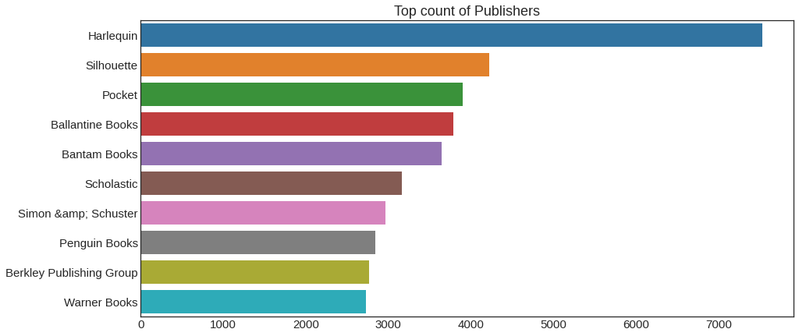
Top 10 publisher counts

Slide 14
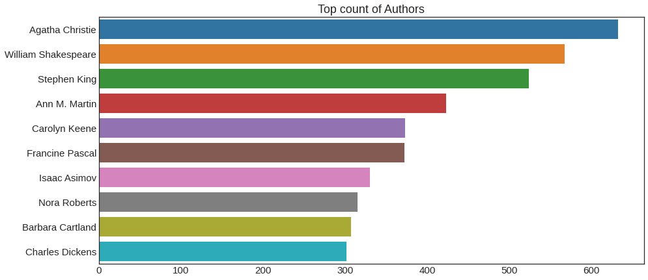
Top 10 author counts

Slide 15
TOP 10 BOOK TITLES
TITLE | COUNT
Selected Poems | 27
Little Women | 24
Wuthering Heights | 21
Dracula | 20
The Secret Garden | 20
Adventures of Huckleberry Finn | 20
Jane Eyre | 19
The Night Before Christmas | 18
Pride and Prejudice | 18
Great Expectations | 17
This is actually quite an important observation. Although all of the ISBN entries are unique in the 'books' dataframe, different forms of the same book will have different ISBNs - i.e. paperback, e-book, etc. Therefore, we can see that some books have multiple ISBN entries (e.g. Jane Eyre has 12 different ISBNs, each corresponding to a different version of the book).
Let's take a look at, for example, the entries for 'Jane Eyre'.

Slide 16
 | ISBN | book_title | book_author | year_of_publication | publisher
3323 | 0451518845 | Jane Eyre | Charlotte Bronte | 1999.0 | New Amer Library Classics
9545 | 0451523326 | Jane Eyre | Charlotte Bronte | 1988.0 | Signet Classics
27657 | 1566193028 | Jane Eyre | Charlotte Bronte | 1994.0 | Dorset Press
28501 | 156619024X | Jane Eyre | Charlotte Bronte | NaN | Barnes Noble Classics
40050 | 8426102069 | Jane Eyre | Charlotte Bronte | 1997.0 | Juventud
41265 | 0553210203 | Jane Eyre | Charlotte Bronte | 1981.0 | Bantam Books
58243 | 0460012878 | Jane Eyre | Charlotte Bronte | 1976.0 | J m Dent &amp; Sons Ltd
69689 | 0141305371 | Jane Eyre | Charlotte Bronte | 1999.0 | Puffin Books
72306 | 2253004359 | Jane Eyre | Charlotte BrontÃ?Â« | 1991.0 | LGF
84642 | 0812523377 | Jane Eyre | Charlotte Bronte | 1994.0 | Tor Books
84848 | 0809598949 | Jane Eyre | Charlotte Bronte | 2004.0 | Wildside Press
87375 | 3548301231 | Jane Eyre | C Bronte | NaN | Ullstein-Taschenbuch-Verlag, Zweigniederlassun...
144292 | 0517668432 | Jane Eyre | Charlotte Bronte | 1988.0 | Random House Value Publishing
158858 | 1853268348 | Jane Eyre | Charlotte Bronte | NaN | Universal Sales Marketing
166665 | 2266083252 | Jane Eyre | Charlotte BrontÃ?Â« | 1999.0 | Pocket
204658 | 0451515560 | Jane Eyre | Charlotte Bronte | 1981.0 | Signet Book
226926 | 0582528259 | Jane Eyre | Charlotte Bronte | 1978.0 | Addison-Wesley Pub Co
242914 | 1590071212 | Jane Eyre | Charlotte Bronte | 2002.0 | New Millenium Audio
248967 | 843761449X | Jane Eyre | Charlotte Bronte | 1998.0 | Ediciones Catedra S.A.
72306 | 2253004359 | Jane Eyre | Charlotte BrontÃ?Â« | 1991.0 | LGF
84642 | 0812523377 | Jane Eyre | Charlotte Bronte | 1994.0 | Tor Books
84848 | 0809598949 | Jane Eyre | Charlotte Bronte | 2004.0 | Wildside Press
87375 | 3548301231 | Jane Eyre | C Bronte | NaN | Ullstein-Taschenbuch-Verlag, Zweigniederlassun...
144292 | 0517668432 | Jane Eyre | Charlotte Bronte | 1988.0 | Random House Value Publishing
158858 | 1853268348 | Jane Eyre | Charlotte Bronte | NaN | Universal Sales Marketing
166665 | 2266083252 | Jane Eyre | Charlotte BrontÃ?Â« | 1999.0 | Pocket
204658 | 0451515560 | Jane Eyre | Charlotte Bronte | 1981.0 | Signet Book
226926 | 0582528259 | Jane Eyre | Charlotte Bronte | 1978.0 | Addison-Wesley Pub Co
242914 | 1590071212 | Jane Eyre | Charlotte Bronte | 2002.0 | New Millenium Audio
248967 | 843761449X | Jane Eyre | Charlotte Bronte | 1998.0 | Ediciones Catedra S.A.
It looks like each ISBN assigned to the book 'Jane Eyre' has different Publisher and Year of Publication values also.

Slide 17
It might be more useful for our model if we simplified this to give each book a unique identifier, independent of the book format, as our recommendations will be for a book, not a specific version of a book. Therefore, all values in the Jane Eyre example above would stay the same, except all of the Jane Eyre entries would additionally be assigned a unique ISBN code as a new field.
Will create this more unique identifier under the field name 'unique_isbn'. Note that entries with only a single ISBN number will be left the same. However, we need to do this after joining to the other tables in the dataset, as some ISBNs in the 'book-rating' table may be removed if done prior.

Slide 18
INVESTIGATING BOOK_RATINGS dataset
 | user_id | ISBN | book_rating
0 | 276725 | 034545104X | 0
1 | 276726 | 0155061224 | 5
2 | 276727 | 0446520802 | 0
3 | 276729 | 052165615X | 3
4 | 276729 | 0521795028 | 6
The datatypes all look good. ISBN contains letters so it should be object.
The top 5 users are 11676, 198711, 198711, 153662, 98391

Slide 19
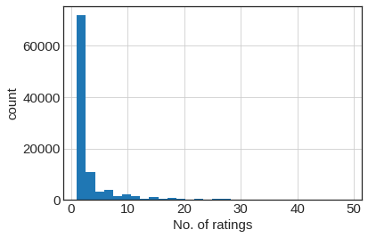
Users distribution – with more than 50 ratings removed
It looks like by far the most frequent events are users with only 1 or 2 rating entries. We can see that the 'super users' with thousands of ratings are significant outliers.

Slide 20
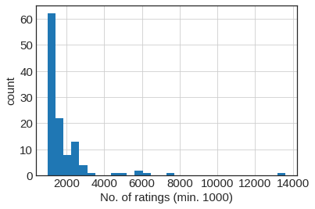
Users with more than 1000 ratings

Slide 21
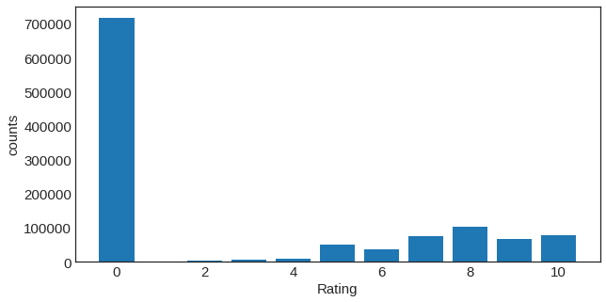
Ratings distribution
Seems like most of the entries have a rating of zero!
After doing some research on the internet regarding this (and similar) datasets, it appears that the rating scale is actually from 1 to 10, and a 0 indicates an 'implicit' rather than an 'explicit' rating.
For the modeling step we'll only be looking at explicit ratings, and so the 0 rating entry rows will be removed

Slide 22
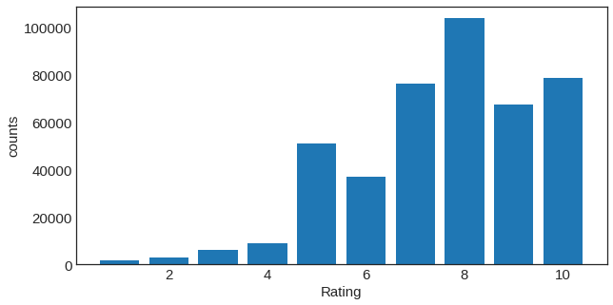
By removing the implicit ratings we have reduced our sample size by more than half.
Size of book_ratings before removing zero ratings: 1149780 Size of book_ratings after removing zero ratings: 433671
Now we can see that 8 is the most frequent rating, while users tend to give ratings > 5, with very few low ratings given.

Slide 23
JOINING BOOKS WITH BOOK_RATINGS TABLE
Books table size: 271343 Ratings table size: 433671 New table size: 433671
There are 49856 books with no title/author information. This represents 8.70% of the ratings dataset.
It looks like the year_of_publication field contains the most NaN entries, while user_id, isbn, and book_rating are full. The book_title, book_author, and publisher fields contain approximately the same number of missing entries.
We'll choose to remove rows for which the book_title is empty, as this is the most crucial piece of data needed to identify the book.

Slide 24
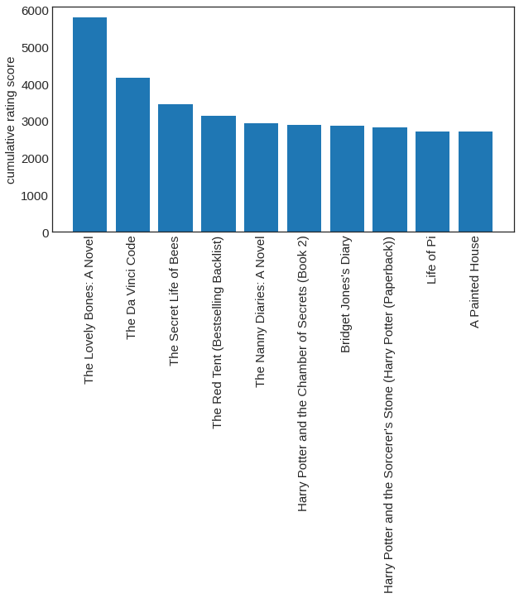
Highest cumulative book ratings

Slide 25
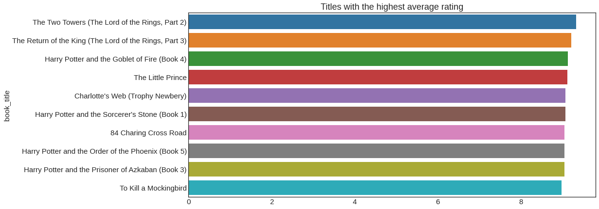
TITLES WITH THE HIGHEST AVG RATING

Slide 26
Books with lowest rating
Slow Waltz in Cedar Bend 6.619718
My Gal Sunday 6.607843
Hornet's Nest 6.591398
Bleachers 6.583333
Full Tilt (Janet Evanovich's Full Series) 6.568627
Songs in Ordinary Time (Oprah's Book Club (Paperback)) 6.530303
4 Blondes 5.653846
Isle of Dogs 5.433962
Four Blondes 5.393939
Wild Animus 4.390706
Seems like the lowest average rating in the dataset is only a 4.39 - and all the rest of the books have average ratings higher than 5.

Slide 27
Restrict books to a "single ISBN per book" (regardless of format)
We can see that the vast majority of books have less only 1 associated ISBN number, however quite a few multiple ISBNs. We want to create a unique_isbn such that a single book will only have 1 identifier when fed to the recommendation model.
There are 10231 book titles with multiple ISBN numbers which we will try to re-assign to a unique identifier. For instance, Jane Eyre has 14 ISBN such as ‘1590071212', '0451518845', '0451523326', '843761449X', '156619024X', '8426102069', '1566193028', '0141305371', '3548301231', '0812523377', '0517668432', '2253004359', '0553210203', '0451515560’
ISBN numbers refers to (from what I understand the code actually signifies various things including publisher, year, type of print, etc, but decoding this is outside the scope of this analysis), I'll just select the first ISBN number that appears in the list of values to set as our unique_isbn for that particular book.

Slide 28
NOTE: ISBN numbers are currently 13 digits long, but used to be 10. Any ISBN that isn't 10 or 13 digits long is probably an error that should be handled somehow. Any that are 9 digits long might actually be SBN numbers (pre-1970), and can be converted into ISBN's by just pre-fixing with a zero.
We won't replace the original ISBN column with the 'unique_isbn' column, but just note that the recommendation model should be based on the 'unique_isbn' field.
The unique_isbn is the first isbn from the list of isbn

Slide 29
2.Joining all the tables
Books+Ratings table size: 433671 Users table size: 278858 New "books_users_ratings" table size: 433671
There are 12 new attributes after combining the datasets.
There are a few missing year_of_publication, publisher, and country entries, but the primary fields of user_id, unique_isbn, and book_rating are all full, which is good.
In terms of the data types, user_id and book_rating are integers, while the unique_isbn are strings (which is expected as the ISBN numbers may also contain letters).

Slide 30
Grouping of users according to ratings
 | Count
book_rating | user_id
1 | 11676 | 133
 | 76499 | 36
 | 233911 | 19
 | 38273 | 17
 | 23872 | 13
... | ... | ...
10 | 278807 | 1
 | 278818 | 1
 | 278831 | 1
 | 278843 | 1
 | 278851 | 1

Slide 31
150971 rows × 1 columns
book_rating | user_id
9 | 98391 | 2652
8 | 11676 | 2138
5 | 189835 | 1826
7 | 11676 | 1597
8 | 98391 | 1514
... | ... | ...
7 | 71616 | 1
 | 71600 | 1
 | 71591 | 1
 | 71570 | 1
10 | 278851 | 1

Slide 32
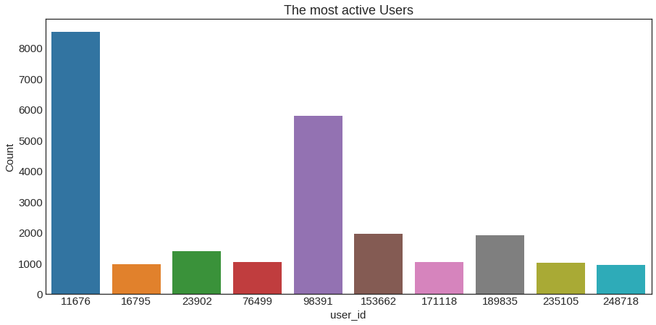
The top 10 most active users

Slide 33
Top 10 most active users with their ids and age
 | user_id | age | count
3160 | 11676 | 35 | 8524
27626 | 98391 | 52 | 5802
43027 | 153662 | 44 | 1969
52924 | 189835 | 35 | 1906
6510 | 23902 | 35 | 1395
21456 | 76499 | 35 | 1036
47780 | 171118 | 47 | 1035
65517 | 235105 | 46 | 1023
4555 | 16795 | 47 | 968
69413 | 248718 | 43 | 948

Slide 34
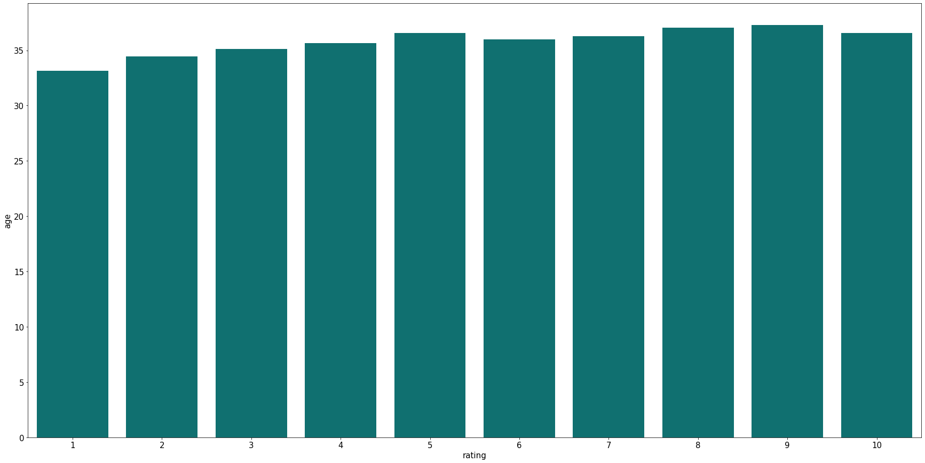
THE age of user who gave most of the ratings

Slide 35
The top books that the most active user 11676 has read
 | book_title | Count
3876 | Pet Sematary | 4
688 | Blessings | 3
4838 | The Bad Beginning (A Series of Unfortunate Eve... | 3
2276 | Harry Potter and the Chamber of Secrets (Book 2) | 3
4105 | Remember Me | 3
35 | 84 Charing Cross Road | 3
6128 | Tiger Eyes | 3
5767 | The Secret Garden | 3
1117 | Cradle and All | 3
5891 | The Testament | 3

Slide 36
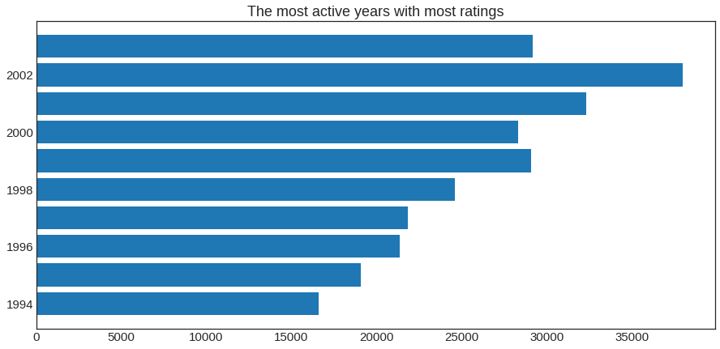
The most active year of publication

Slide 37
The year with most publications
 | year_of_publication | book_rating
87 | 2002.0 | 37986
86 | 2001.0 | 32331
88 | 2003.0 | 29166
84 | 1999.0 | 29100
85 | 2000.0 | 28318
83 | 1998.0 | 24625
82 | 1997.0 | 21857
81 | 1996.0 | 21361
80 | 1995.0 | 19103
79 | 1994.0 | 16596

Slide 38
The authors with the most publications in the most active year
 | book_author | count
0 | Alice Sebold | 843
1 | James Patterson | 553
2 | Nora Roberts | 397
3 | Janet Evanovich | 323
4 | Stephen King | 317
5 | John Grisham | 317
6 | Jennifer Weiner | 264
7 | Neil Gaiman | 240
8 | Emma McLaughlin | 228
9 | Nick Hornby | 215

Slide 39
The publishing companies that received most business in the most active year
 | publisher | count
0 | Ballantine Books | 1308
1 | Pocket | 1197
2 | Little, Brown | 1086
3 | Berkley Publishing Group | 857
4 | Warner Books | 857
5 | HarperTorch | 845
6 | Perennial | 756
7 | Harlequin | 749
8 | Signet Book | 727
9 | Avon | 682

Slide 40
Authors belonging to the same publishing company
publisher | book_author | Count
Editions P. Terrail | Laure Meyer | 1
Tri-State Press | Isabel Jansen | 1
'K' Pub | Khadijah Hashim | 1
10-18 | Arthur Upfield | 11
 | Lilian Jackson Braun | 6
 | Joseph Bedier | 4
 | Hubert Selby | 3
 | Anne de Leseleuc | 2
 | Bret Easton Ellis | 2
 | Robert Van Gulik | 2
 | Amanda Cross | 1
 | Edith Wharton | 1

Slide 41
Publishing companies that recEived the most business from the same author
publisher | book_author | count
Signet Book | Stephen King | 1593
Jove Books | Nora Roberts | 1342
Scholastic | J. K. Rowling | 1152
Warner Books | Nicholas Sparks | 966
Silhouette | Nora Roberts | 952
Berkley Publishing Group | Tom Clancy | 926
Dell Publishing Company | John Grisham | 925
Ballantine Books | Anne Rice | 900
Berkley Publishing Group | Dean R. Koontz | 893
St. Martin's Paperbacks | Janet Evanovich | 884

Slide 42
AGE WISE PREFERENCE OF BOOKS
 | Age | Title | Count
0 | 34 | The Lovely Bones: A Novel | 258
1 | 34 | A Painted House | 166
2 | 34 | The Red Tent (Bestselling Backlist) | 166
3 | 34 | The Nanny Diaries: A Novel | 157
4 | 34 | The Secret Life of Bees | 140
... | ... | ... | ...
280363 | 33 | City Infernal | 1
280364 | 33 | City critters: How to live with urban wildlife | 1
280365 | 33 | City of Bones | 1
280366 | 33 | City of God | 1
280367 | 100 | Wuthering Heights (Dover Thrift Editions) | 1

Slide 43
Country-WISE PREFERENCE OF BOOKS
 | Country | Title | Count
0 | usa | The Lovely Bones: A Novel | 531
1 | usa | The Da Vinci Code | 396
2 | usa | The Secret Life of Bees | 360
3 | usa | The Nanny Diaries: A Novel | 321
4 | usa | A Painted House | 309
... | ... | ... | ...
176250 | netherlands | Cruel &amp; Unusual (Kay Scarpetta Mysteries (... | 1
176251 | netherlands | Crossings (Buffy the Vampire Slayer) | 1
176252 | netherlands | Crime and Punishment (Wordsworth Classics) | 1
176253 | netherlands | Cries in the Desert (St. Martin's True Crime L... | 1
176254 | usa, rhode island, usa | A Letter to Mrs. Roosevelt | 1

Slide 44
3.MODEL BUILDING
1. Popularity based filtering
2. Model based collaborative filtering
3. Recommendation using knn

Slide 45
1.Popularity based recommendation
As the name suggests Popularity based recommendation system works with the trend. It basically uses the items which are in trend right now. For example, if any book which is usually bought by every new user then there are chances that it may suggest that book to the user who just signed up
Book weighted average formula: Weighted Rating(WR)=[vR/(v+m)]+[mC/(v+m)]
Where, v is the number of votes for the books;
m is the minimum votes required to be listed in the chart;
R is the average rating of the book;
C is the mean vote across the whole report.

Slide 46
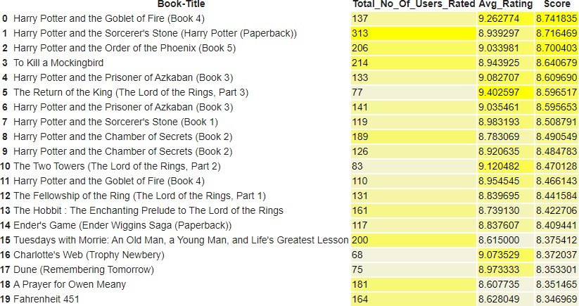
The Popularity based recommender provide a general chart of recommended books to all the users. They are not sensitive to the interests and tastes of a particular user.

Slide 47
2.Model based collaborative filtering
Model based approach involves building machine learning algorithms to predict user's ratings.
They involve dimensionality reduction methods that reduce high dimensional matrix containing abundant number of missing values with a much smaller matrix in lower-dimensional space.
The goal is to compare SVD and NMF algorithms, try different configurations of parameters and explore obtained results.
Training set size: 307052
Testing set size: 76763
Test set is 20% of the full dataset

Slide 48
Singular Value Decomposition (SVD) and Non-negative Matrix Factorization (NMF) are matrix factorization techniques used for dimensionality reduction. Surprise package provides implementation of those algorithms.
Evaluating RMSE of algorithm SVD on 5 split(s)
Fold 1 Fold 2 Fold 3 Fold 4 Fold 5 Mean Std
Test set 1.6383 1.6369 1.6301 1.6448 1.6343 1.6369 0.0048
Fit time 14.13 12.00 9.85 8.90 10.00 10.97 1.87
Test time 1.63 0.67 0.66 0.67 1.39 1.00 0.42
Evaluating RMSE of algorithm NMF on 5 split(s)
Fold 1 Fold 2 Fold 3 Fold 4 Fold 5 Mean Std
Testset 2.4626 2.4568 2.4761 2.4729 2.4785 2.4694 0.0083
Fit time 31.35 24.24 28.51 26.71 28.85 27.93 2.37
Test time 0.61 0.63 0.61 0.58 1.37 0.76 0.31
It's clear that for the given dataset much better results can be obtained with SVD approach - both in terms of accuracy and training / testing time.

Slide 49
Optimisation of SVD algorithm Grid Search Cross Validation computes accuracy metrics for an algorithm on various combinations of parameters, over a cross-validation procedure.
It's useful for finding the best configuration of parameters.
It is used to find the best setting of parameters:
n_factors - the number of factors
lr_all - the learning rate for all parameters
reg_all - the regularization term for all parameters
As a result, regarding the majority of parameters, the default setting is the most optimal one. The improvement obtained with Grid Search is very small.
Evaluating RMSE, MAE of algorithm SVD on 5 split(s).
Fold 1 Fold 2 Fold 3 Fold 4 Fold 5 Mean Std
RMSE (testset) 1.6330 1.6317 1.6297 1.6376 1.6220 1.6308 0.0051
MAE (testset) 1.2618 1.2589 1.2585 1.2642 1.2532 1.2593 0.0037
Fit time 5.53 5.64 5.69 5.65 5.70 5.64 0.06
Test time 1.01 0.99 0.61 0.63 0.60 0.77 0.19

Slide 50
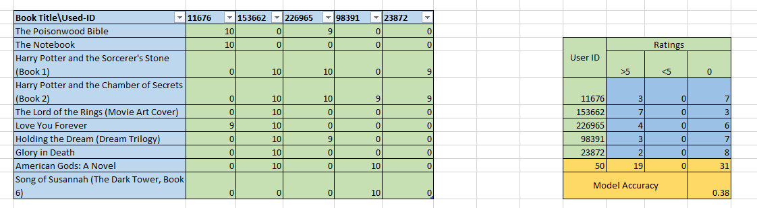
3.Recommendation using KNN
The algorithm used for implementing the recommendation system using KNN are
Cosine similarity
Nearest Neighbors

Slide 51
4.MODEL EVALUATION
From the above three models we built and by comparing their RMSE values,we use recommendation using KNN for model deployment (user based), where we need to give the user-id to get the recommendation of books.

Slide 52

5.Model Deployment
Using Streamlit, we deployed our model of book recommendation system using KNN as below:

Slide 53
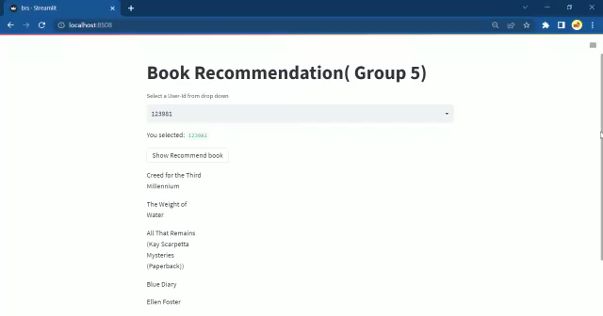

Slide 54
THANK YOU

